Slide 1
Payment Systems
Zamir Afzal Khan
Sr. Joint Director
Payment Systems Department
State Bank of Pakistan

Slide 2
Agenda
Understanding Payment Systems
Payment Instruments
Clearing
Settlements
Regulatory Objectives
Regulatory Framework
Initiatives

Slide 3
Payment Systems
Definition
“A set of instruments, procedures, and rules for the transfer of funds between or among participants; within a geographical boundary. The system includes the participants and the entity operating the arrangement e.g. retail payment system and LVPS”
Markets
Retail and Wholesale
Capital and Commodity
Money
FX
Notes:
“No economic activities are possible without the transfer of money. In this sense, it can be said that payment systems are one of the most significant social infrastructures.”
Can you give examples of some of the payment systems in your country?
As you can see there are different terms used in this definition. For example one is “Set of Payment Instrument” can you give any examples
Yes, credit transfers, direct debit, cheques, credit cards, debit cards, e-money etc, all these are instrument. But each of these instruments have different characteristics.
So what's the difference between the credit transfers and payment cheques, besides the physical differences. Credit Transfers are basically push instruments. Push instrument means that you can simply push the payment into an account vs the pull instrument where the beneficiary has to deposit the instrument into his account and the payment gets pulled by the beneficiary’s intitutions
Which payment instrument is more risky Pull or Push and why?

Slide 4
Relationship (Market & Infra)
Retail
Whole Sale (Corporate)
Foreign Exchange Market
Commodity Market
Capital Market
Money Market
Market Related Trade Reporting System(s)
Trading
Delivery Systems (Ownership Transfer like CDC etc)
Buyer
Deal Making
Delivery
Seller
Deal Completion
Payment
Payment Systems
Banks
Source: NPS South Africa

Slide 5
Relationship (Market & Infra)
Trade Reporting Systems
KATS
Reuters
Delivery Systems
CDC
PRISM (securities)
Payment & Settlement Systems
Cheque Clearing Systems
Interbank Fund Transfers
PRISM (RTGS) System

Slide 6
Payment Instruments
Cash
Cards
Credit Transfers (IBFT, RTGS, SWIFT)
Cheques
Digital Currencies (BitCoin)
Notes:
You all are familiar with these instruments especially cash. Besides cash every type of instrument has settlement risk i.e. whether the counterparty is going to get the payment when it is due to not. We’ll also briefly touch the digital currencies.

Slide 7
Characteristics of Payment Instruments
Push Instrument
Credit Transfers,
No Credit Risk
Less Complicated
Pull Instrument
Cheques, Cards
Credit Risk
More Complicated
Push Instrument are preferred choice for digital payments

Slide 8
Payment Cards
Cards (Credit Card, Debit Card, Prepaid Cards)
Participants
Customer
Merchant
Issuing Bank
Acquiring Bank
Payment Schemes
Transaction Types
Card Present
Card Not Present

Slide 9
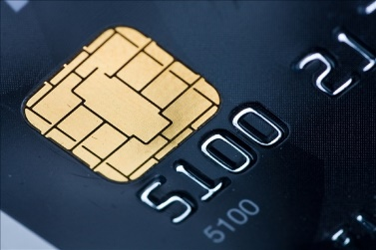
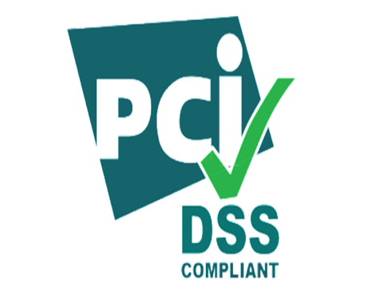
Payment Card Security
Fraud protection and data security
EMV chip: Technology that uses secret cryptographic keys to help protect against fraud at the point of sale and make payment cards more difficult to counterfeit.
3-D Secure is an XML-based protocol designed to be an additional security layer for online credit and debit card transactions
PCI Security Standards: Security controls for making sure that customer's card data is kept secure throughout the entire transaction process.

Slide 10
Payment cards
For FY 2017-18 (for period 01-Jul-17 to 30-Jun-18)
Credit Cards | 1,453,867
Debit, ATM only, Prepaid and Social Welfare Cards | 39,465,126
POS Terminals | 53,511
Credit Card Issuers | 12
Debit Card Issuers | 31
Debit Card Transactions - Volume | 438.4 million
Debit Card Transactions - Value | 5075.9 billion
Credit Card Transactions - Volume | 35.4 million
Credit Card Transactions - Value | 201.5 billion
POS Acquirers | 9
POS per 100,000 Population | 26

Slide 11
Credit Transfers
IBFT (1-Link)
For retail payments
Enables banks to offer Inter Bank Fund Transfers using ATMS, Internet Banking and Call Centers
Charges determined by the banks individually.
PRISM Transfers (SBP)
For Large Value Payment
Credit transfers through bank branches
Charges determined by SBP

Slide 12
Cheque Clearing
CUSTOMER A
OF MCB
1. A SENDS CHECK TO B
CUSTOMER B
OF CITIBANK
“PAY B Rs 100”
2. B DEPOSITS
CHECK AT CITI
MCB BANK
CUSTOMER C
CUSTOMER A
. . .
CUSTOMER Y
CUSTOMER Z
7. CLEARING HOUSE
SENDS CHECK TO
MCB
CITIBANK
CUSTOMER A
CUSTOMER B
. . .
B
CUSTOMER Z
4. CITI SENDS CHECK
TO CLEARING HOUSE
-100
CLEARING HOUSE
(NIFT)
MCB
BANK A
. . .
BANK Z
CITIBANK
+100
-100
8. MCB DEDUCTS Rs 100 FROM A ACCOUNT
6. CLEARING HOUSE SENDS MCB DEBIT INFO
3. CITIBANK CREDITS
B WITH Rs 100
+100
5. CLEARING HOUSE ADDS Rs 100 TO CITI,
SUBTRACTS Rs 100 FROM MCB

Slide 13
Clearing-Paper Instruments
Clearing Procedure
From banks to clearing house to banks
Clearing Batches
Same day, Normal & Intercity
Clearing House (NIFT)
More than 28 offices & Hubs
Processing of cheques based on MICR using sorters
Preparation of Clearing Batches
Submission of Clearing Batches

Slide 14
Clearing
Clearing Infrastructure is required to process payment instruments’ settlement between different financial institutions and their customers
E.g. Cheques drawn on other banks, credit transfers sent to other banks’ customer
Clearing can be physical, automated or electronic
Major clearing institutions in Pakistan (NIFT, 1-Link, NCCPL)
The process of transmitting, reconciling and, in some cases, confirming payment orders or security transfer instructions prior to settlement, possibly including the netting of instructions and the establishment of final positions for settlement. Sometimes the term is used (imprecisely) to include settlement. (BIS)

Slide 15
Clearing Methods
Bilateral Settlements
Between two financial institutions. Typically used FX transactions
Low risk but inefficient for retail payments
Multilateral Net
Net settlement between multiple institutions. Used for retail payment
Efficient Settlement but high risk as any participants default can result in systemic risk
Done by clearing houses like NIFT and 1-Link etc.

Slide 16
Bi Lateral Netting
A-B=25
75
Bank A
Bank B
100
Payment Obligations
75
25
90
85
30
C-A=50
85
D-B =55
Bank C
Bank D
45

Slide 17
Funds Transfers Under Bilateral Clearing
Bank A
Bank B
25
90
50
(75-25)
55 (85-30)
Bank C
Bank D
30

Slide 18
Funds Transfers Under Multilateral Clearing
Bank A
Bank B
140
240
Clearinghouse
10
90
Bank C
Bank D

Slide 19
Settlement
The completion of transaction or of processing with the aim of discharging participants’ obligations through the transfer of funds and/or securities.
Settlement methods can be Gross or Net.
Gross Settlement used for Wholesale payments. Requires more liquidity but less risky
Net Settlement used for retail payment. More risk but requires less liquidity.
Wholesale Payment Systems such as PRISM settles on Real Time Gross Settlement (RTGS) basis.

Slide 20
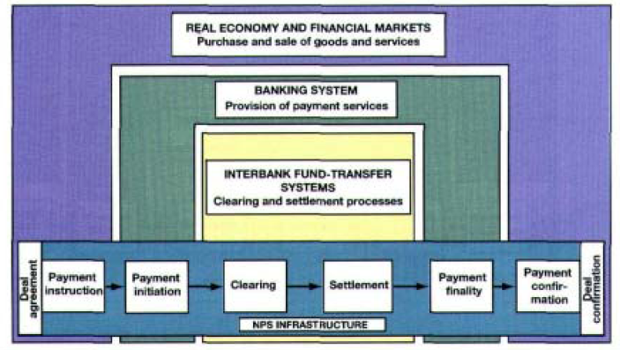
Trading and Payment (Distinction)
Source NPS: South Africa

Slide 21
Payment System &Economy
Real Economy and Financial Markets
Purchase and Sale of goods and services
Banking System
Provision of Payment Services
IBFT
Clearing and Settlement Processes
Central Bank
Source NPS: South Africa

Slide 22
Regulatory Objectives
Safety and Efficiency in Payment Systems
Payment Instruments, Alternate Delivery Channels, Clearing Houses, Payment Systems Operators and Payment Service Providers, Financial Institutions.
Risks
Legal, Liquidity, Credit, Settlement, Custody, Agent, FX Settlement
Implementation Powers
Legal Powers under BCO 1962 and PS&EFT Act 2007

Slide 23
Regulatory Focus
Payment Systems
Payment Instrument
Alternate Delivery Channels
Clearing Houses
Payment Schemes
Payment System Operators
Payment Service Providers

Slide 24
Payment Card Security
Payment Cards security Regulations (2016) Milestones
Acquiring Infrastructure Compliance – Dec 31, 2017
Issuing of EMV compliant Cards – Jun 30, 2018
Chip and PIN – Dec 31, 2018
Challenges
Availability of Vendors (TPS and Avanza)
Inadequate testing facilities and certification slots
Capital Intensive (Hardware, Middleware, Development costs etc.)

Slide 25
Regulatory Framework
Electronic Fund Transfer Rules
Payment Message Transparency and standardization by routing originator and beneficiary information
Name of the Originator, beneficiary
Name of the Beneficiary
Originator’s IBAN / Mobile Account Number (if applicable)
Originating AFI Name, Beneficiary AFI Name
Transaction reference number
Amount of transaction
Responsibilities of originating and beneficiary financial institutions and PSOs/PSPSs
Compensation policy

Slide 26
Regulatory Framework
Internet Banking Security Regulations (2015)
Risk Management framework
Minimum set of operational, administrative, technical and physical safeguards to secure Internet Banking offered
Two Factor Authentication
Clearing Guidelines
Fixing responsibilities of each participants in Clearing Cycle
Centralized Intercity Clearing
Clearing Operations in Remote Areas and its settlement through RTGS on bilateral basis
Compensation for Delayed Payments
Standardized Return codes

Slide 27
Digital Payments Security Circular
Vulnerability assessment and penetration testing of systems
Setting bank-wise limits with international payment schemes.
Activation of any internet banking after biometrics
Deployment of fraud monitoring systems, use of threat intelligence
Customers to activate or block their cards for online/cross-border transactions
Free of cost SMS transaction alerts
Bank/MFB to compensate customers within two (02) business days
Banks to issue chip and pin cards, pin authentication for e-commerce transaction,

Slide 28
New Initiatives
Guidelines for White Label ATM Operators
Allow non banks to own and operate ATMs
Pricing based on consumer consent
EMI Regulations
Allow non banks to hold consumer money for the purpose of payments
Credit product is not allowed
the amount taken by EMI shall not be treated as depots
Customer Due diligence
Transactions limits
licensing Criteria
oversight and supervision

Slide 29
Infrastructure Initiatives
Automated Transfer Systems
Automated Clearing House
Bulk Transfers
Delivery Vs Payment Settlement
Payment Vs Payment Settlement
International Messaging Standards
Micro Payment Gateway
Focus on Micro Payments and Financial Inclusion
Instant Retail Payments

Slide 30
Thanks

